Slide 1
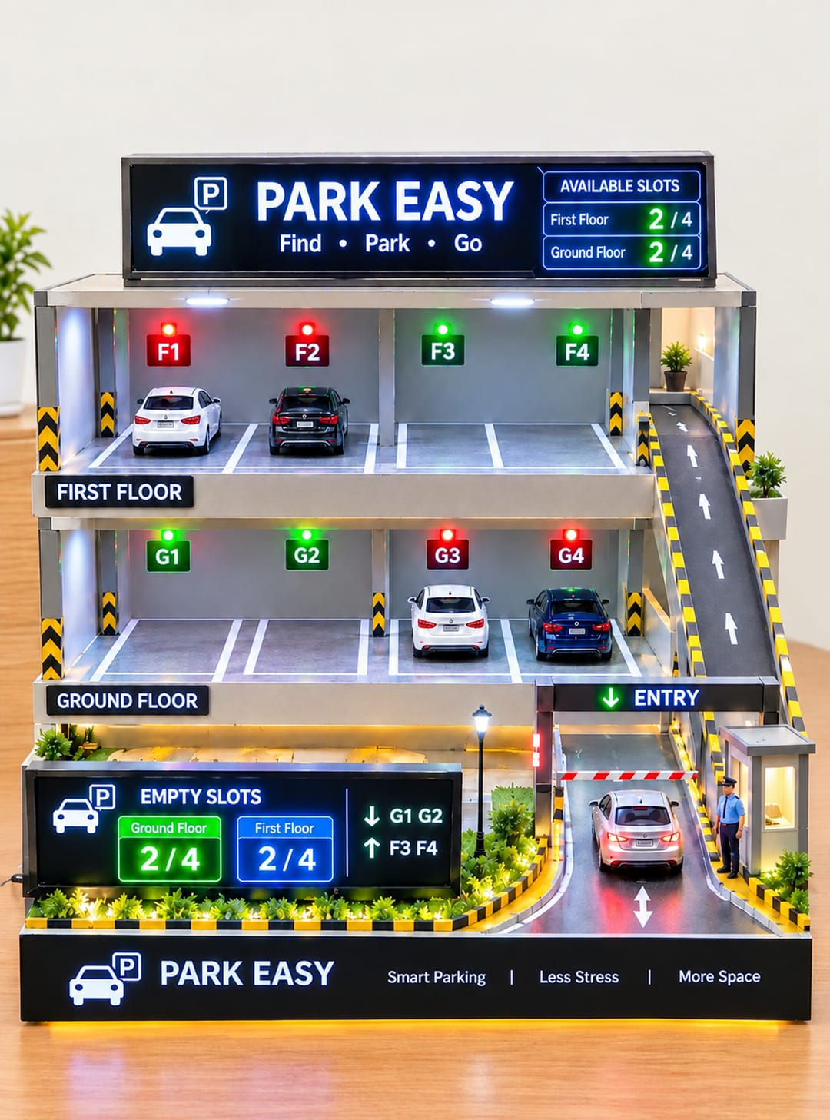
YUKTHI 2026 | TECHNICAL HACKATHON
PARK EASY
THE AI PARKING ASSISTANT
Smart Parking. Less Traffic. Better Cities.
Theme: AI and Automation
Team Name: NOVA
Team Members: 6 Members
Institution: KSRM College of Engineering (KSRMCE)
An intelligent, parking management system that detects parking availability in real time and guides drivers toward vacant parking spaces.

Slide 2
Problem Statement
02
The Problem: Inefficient Parking Management
What problem are we solving?
Key challenges
Finding an available parking space in crowded locations such as colleges, shopping centres, hospitals and offices is often time-consuming.
Traditional systems make drivers search manually, causing unnecessary vehicle movement.
Real-Time Slot Detection
1
Detecting whether parking spaces are occupied or available using sensors.
Multi-Floor Parking Management
2
Monitoring available parking spaces across multiple floors simultaneously.
PROBLEM STATEMENT
Real-Time Data Updates
3
Updating the display immediately whenever a vehicle enters or leaves a parking slot.
How can we develop an affordable, intelligent parking system that automatically detects vacant spaces, displays real-time availability, and guides drivers to suitable parking locations?
Accurate Slot Identification
4
Displaying the correct parking slot number and floor on the display.

Slide 3
Proposed Solution
03
Goal: cut parking search time and make parking management smarter and more convenient
How Park Easy works
Example: our prototype
Sensors detect whether a vehicle is present in a parking slot.
8
1
TOTAL SLOTS
2
An ESP32 or Arduino collects the sensor data.
4
Wi-Fi transmits the parking status to the dashboard.
OCCUPIED
3
4
4
The dashboard displays available slots.
AVAILABLE
Ground floor 2/4 and first floor 2/4 free, shown on the display and by green / red slot lights.
5
Drivers identify a suitable space before entering the parking area.

Slide 4
Key Features
04
Intelligent features of ParkEasy, from live detection to analytics
1
Real-Time Slot Detection
2
Sensor-Based Monitoring
Automatically identifies vacant and occupied parking spaces.
Affordable sensors detect vehicle presence in each slot.
3
Live Parking Dashboard
4
Smart Parking Guidance
Shows total, occupied and available spaces in real time.
Slot numbers and visual indicators lead drivers to free slots.
5
Multi-Floor Management
6
Automated Alerts
Floor-by-floor availability for multi-level buildings.
Signals when spaces open up or the parking area is full.
7
Digital payments
8
Online booking
Supports options such as UPI, cards, cash, and digital wallets.
Users can reserve parking spaces in advance
9
Automatic Barrier Control
10
Time and Fuel Saving
Servo-operated barrier for entry and exit demonstrations.
Minimizes unnecessary driving inside parking areas

Slide 5
Implementation Approach
05
Expected outcome: a working prototype that detects parking availability and shows it on a live dashboard
1
Design the Parking Model
Build a miniature parking area with numbered slots; a two-floor model shows multi-level management.
2
Install Sensors
Place an IR or suitable vehicle-detection sensor at each parking slot.
3
Connect the Controller
Use an ESP32 or NodeMCU ESP8266 to collect and process sensor readings.
4
Develop Monitoring
Program the controller to decide whether each slot is available or occupied.
5
Establish Communication
Use Wi-Fi to send parking information to a local web dashboard or other supported display.
Our two-floor model
6
Create the Dashboard
Show slot status by colour: Green = available, Red = occupied, Yellow = reserved or restricted (if implemented).
7
Integrate Smart Features
Add a servo-based entry barrier and parking alerts where feasible.
8
Test and Demonstrate
Place and remove toy vehicles in different slots to verify that the displayed status updates correctly.

Slide 6
Budget & Components
06
Estimated prototype cost: ₹1,650–₹3,700
Component | Estimated Cost
ESP32 or NodeMCU ESP8266 | ₹300–₹500
IR Sensors (4–8 units) | ₹200–₹500
Servo Motor for Barrier | ₹100–₹200
Breadboard and Jumper Wires | ₹150–₹300
LEDs and Resistors | ₹50–₹100
Power Supply and USB Cable | ₹200–₹400
Parking Model Materials | ₹400–₹800
Miscellaneous Components | ₹250–₹900
Estimated Total | ₹1,650–₹3,700
Essential hardware
ESP32 or NodeMCU ESP8266
IR or similar vehicle sensors
Breadboard, wires, LEDs, resistors
Servo motor (optional barrier)
USB power; foam board model
Software requirements
Arduino IDE
Embedded C/C++ for the controller
HTML, CSS, JavaScript dashboard
Wi-Fi for live status updates

Slide 7
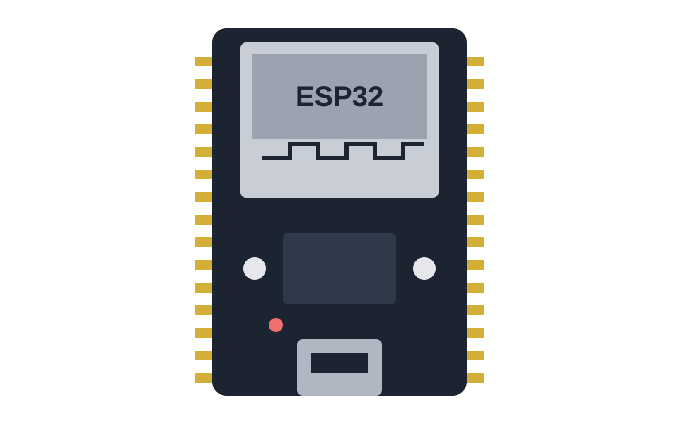
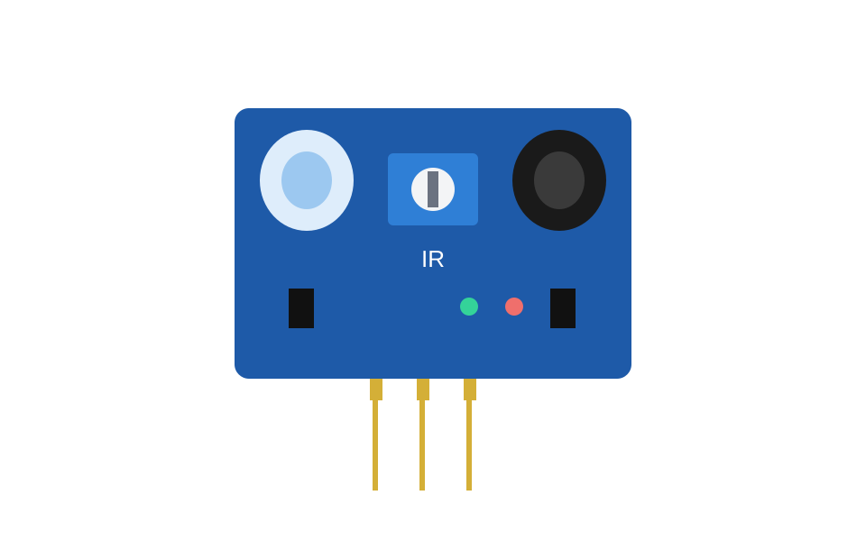
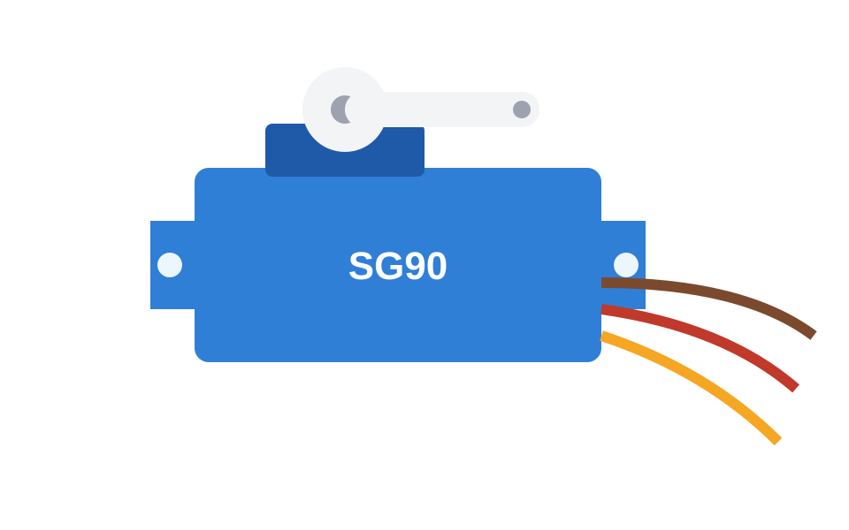
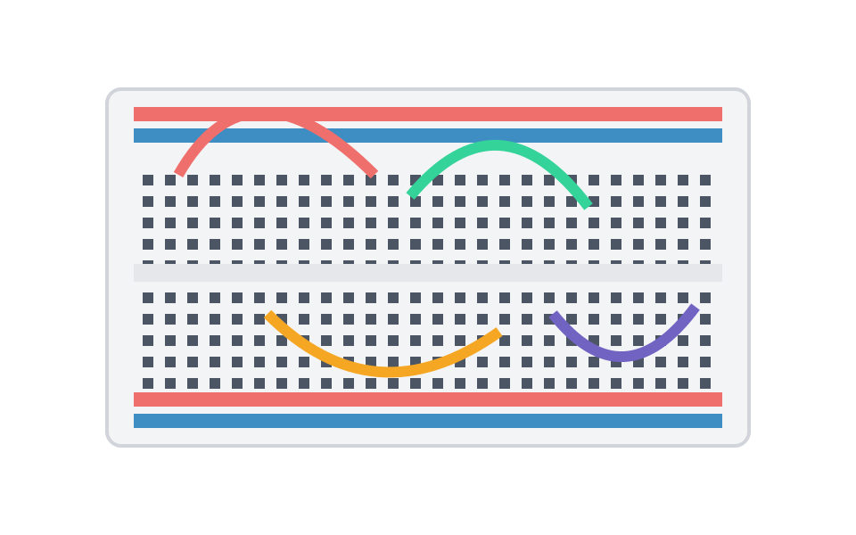

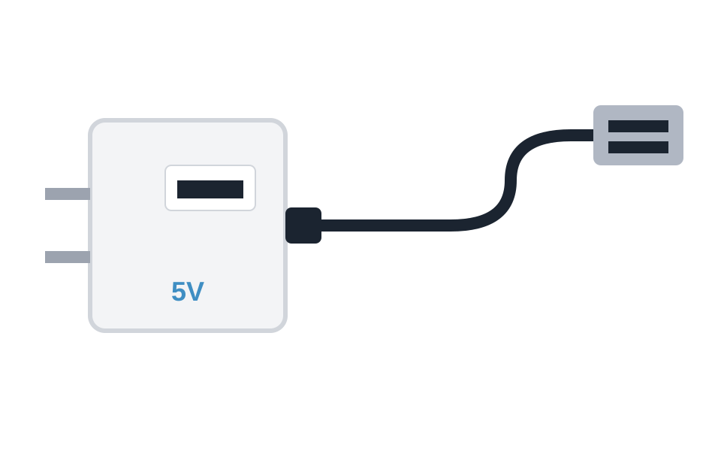
Components Used
07
The main hardware behind the ParkEasy prototype
ESP32 / NodeMCU ESP8266
IR Sensor (4–8 units)
Servo Motor
Controller: reads sensors, sends data by Wi-Fi
Detects whether a vehicle is in each slot
Opens and closes the entry barrier
Breadboard + Jumper Wires
LEDs and Resistors
Power Supply + USB Cable
Solder-free circuit connections
Slot indicators: green, red, yellow
Powers the controller and sensors

Slide 8
Innovation, Impact & Team
08
What makes ParkEasy innovative, who is building it, and where it goes next
Key innovations
Expected impact
Real-time monitoring with automated slot detection
Numbered parking spaces for easy identification
Multi-floor parking status management
Optional automated entry barrier
Suitable for colleges, offices, hospitals, malls
Less time spent searching for parking
Less unnecessary vehicle movement
Better use of existing parking spaces
More organized parking management
A practical, scalable smart-city solution
Team NOVA
Future scope
1
O Sai praneetha
4
K Sravani
Mobile app for parking availability
QR-code or digital parking reservations
Automated entry and exit management
Multi-floor parking navigation
2
G Shardul
5
M Renu Sree
3
N Vyshnavi Sukanya
6
T Niranjan
PARK EASY — Making Every Parking Space Count | Presented by Team NOVA • YUKTHI 2026 • KSRMCE

